Slide 1
Previous Works
Naman Goyal
MS Computer Science (Thesis), Columbia University
Bachelors IIT, Institute Rank 1
Previously - Apple, NAVER, Adobe, Microsoft
ng2848@columbia.edu

Slide 2
Background
Bachelors Computer Science, IIT RPR, Institute Rank 1
Deep Learning Engineer, Vimaan - Startup working with Drones
Intern, Apple
On-device Machine Learning Team
2019-20
2021-Present
2015-19
2020-21
2022
Intern, Microsoft
Intern, NAVER
Computer Vision Research Fellow, Adobe
Masters Research, Machine Learning Columbia University

Slide 3
Some previous works
Visual question answering for on-screen context, Apple
Building Computer Vision pipeline, Vimaan (Startup)
Self Supervised learning approaches for improving Multimodal learning
Improving Image Retrieval in Deep Metric learning, Adobe
Graph Neural Networks for Image Classification using Graph representation
Benchmarking video object detection, NAVER Presentation

Slide 4
Building Computer Vision pipeline
Work done at Vimaan (Startup)

Slide 5
Overview
Vimaan, is a silicon valley startup solving hard challenges in warehouses using Computer Vision and Machine Learning
Main product: Fly a drone in warehouse, capture it in 4K, and run a computer vision pipeline to generate occupancy map of warehouse.
My work included moving this main product from classical solution to deep learning based solution from scratch.
Delivered in 6 months. Then worked on building another system.

Slide 6
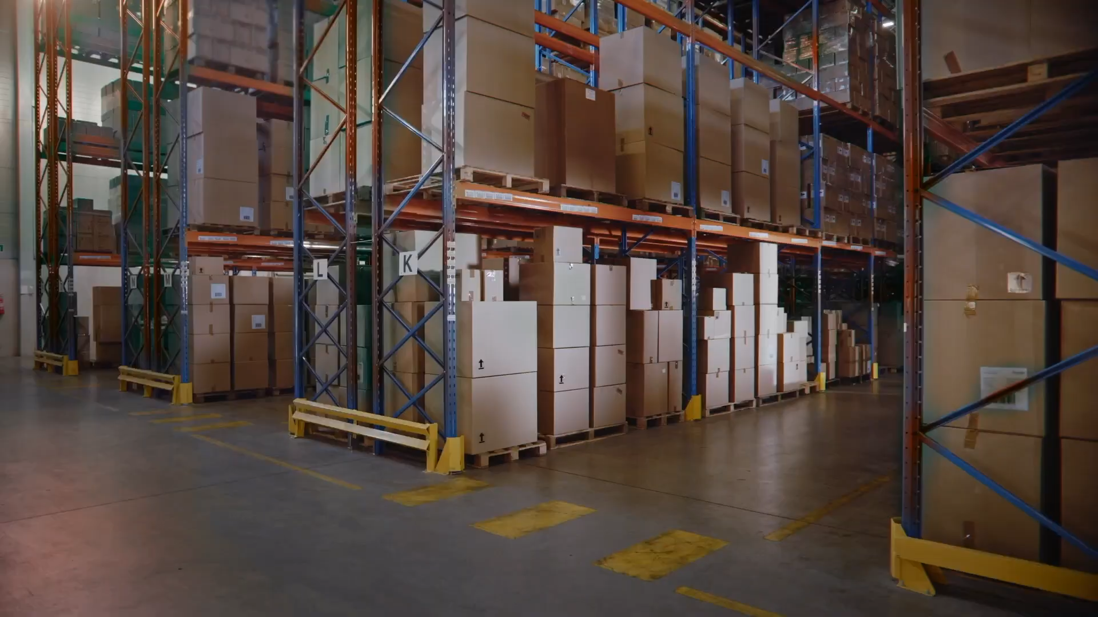

Slide 7
Shelf 1
Shelf 2
Top view of warehouse
Drone
RGB Camera

Slide 8
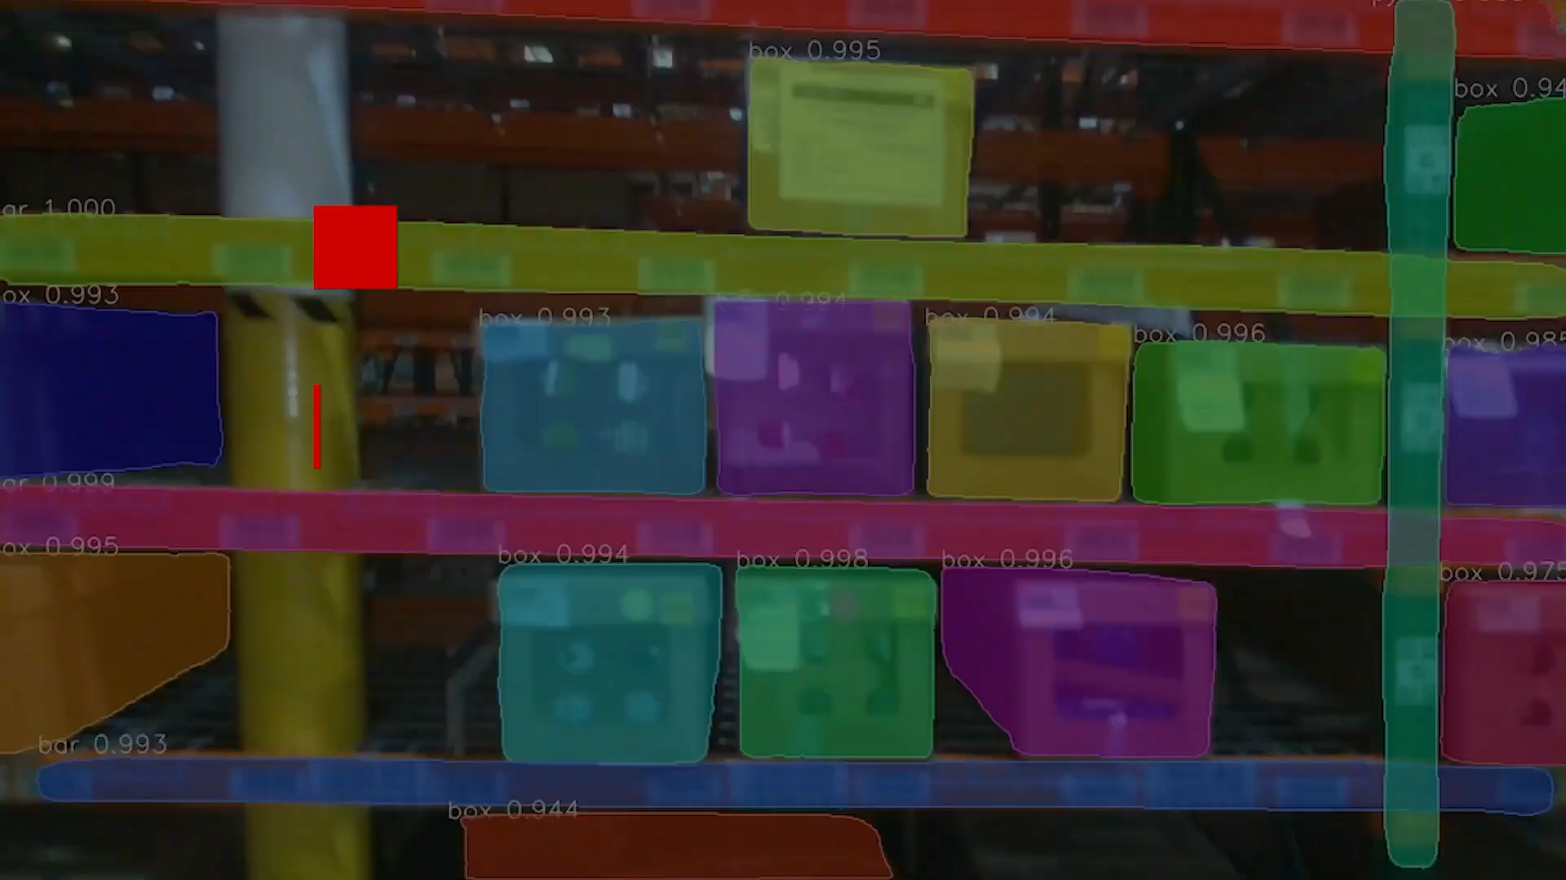
Side view of a shelf

Slide 9
Object 2
Object 1
Side view of a shelf
Label on an object
Bin 1
Bin 2
Bin 3
Frame 1
Frame 2
Frame 3

Slide 10
Design Agreement
Drone is capturing the side view of a shelf as a video.
Detect the object present on the shelf
Find an read label (text+barcode) on object.
Assign the object to a bin a shelf.
Present the final shelf stitched image to client.

Slide 11
Challenges
Since its a video setting, an shelf will be captured in multiple video frames.
An object can be arbitrary shape and be too big to read in a single frame
Should work for arbitrary lightning, occlusion.
The label to be read may contain glare due to flash and any be placed on arbitrary rotation.
Super accurate - No double counting (major loss to company if did)

Slide 12
Solution
Multi stage Deep learning pipeline
Read Text
Instance segmentation
Object Aggregation
Semantic Segmentation (Label)
Stitched Occupancy Map
Input frames
Read barcode

Slide 13
Solution
Multi stage Deep learning pipeline
Read Text
Instance segmentation
Object Aggregation
Semantic Segmentation (Label)
Stitched Occupancy Map
Input frames
Read barcode
Detect box, pylons, boundaries, regions MaskRCNN based

Slide 14
Solution
Multi stage Deep learning pipeline
Read Text
Instance segmentation
Object Aggregation
Semantic Segmentation (Label)
Stitched Occupancy Map
Input frames
Read barcode
Aggregate multiple objects from different frame together

Slide 15
Solution
Multi stage Deep learning pipeline
Read Text
Instance segmentation
Object Aggregation
Semantic Segmentation (Label)
Stitched Occupancy Map
Input frames
Read barcode
Segment out the Label from the box and choose the frame with least glare on the label

Slide 16
Solution
Multi stage Deep learning pipeline
Read Text
Instance segmentation
Object Aggregation
Semantic Segmentation (Label)
Stitched Occupancy Map
Input frames
Read barcode
Deep learning based text detector/ reader and barcode reader. Match there output.

Slide 17
Deployment
Personally read over 20+ papers for coming up with pipeline design, model architecture choice.
Implemented and test over 3-7 different models for each stage of pipeline.
Each module trained end-to-end on its manually annotated data for first iteration.
Each module containerized (docker) and then integrated.
Wrote individual benchmark tests and pipeline level benchmarks.

Slide 18
Impact
Proposed pipeline achieved over 97% accuracy on unseen data from same warehouse.
From next iteration (i.e. moving to new warehouse), the earlier trained system worked with 85% accuracy with no retraining.
Used the previous model iteration to generate initial labels for new warehouse data.
Annotation team fixed the intial labels, much faster than annotating from scratch.
Generalized well to all new warehouse setting after finetuning for edge cases.

Slide 19
Next work
The designed pipeline was so successful that it was then maintained by over 4 engineers in the team.
Moved to a new project, described next

Slide 20
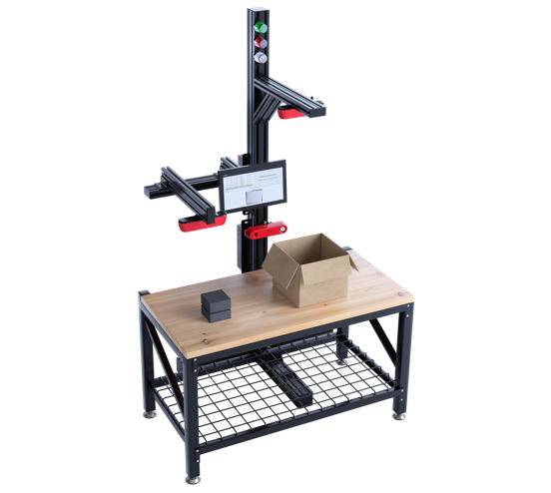
Next work
Make a real-time system which can scan and read objects kept on table.
Camera fit on top of the table
Operator keeps placing objects on the table.
Scan the label on object, and show feedback to operator for successful scan. Or error if no label found on object.
Do an edge device NVIDIA Jetson

Slide 21
Challenges
Do not trigger pipeline for negative cases like
Shadow of camera
Operators moves empty hands on table
If an object is kept on the table, its counted as one object even if kept/moved around.
Edge device - has to be super fast and super light.

Slide 22
Solution
Simplified pipeline for edge device
Read Text
Object spotting trigger
Semantic Segmentation (Object & Label)
Store in DB & show live feedback to operator
Input frames
Read barcode

Slide 23
Solution
Simplified pipeline for edge device
Read Text
Object spotting trigger
Semantic Segmentation (Object & Label)
Store in DB & show live feedback to operator
Input frames
Read barcode
Only runs when there is new object on table
Has a very high recall - don’t want to miss any object

Slide 24
Deployment
Similar to last one, but had to do
model compression
FP16 precision
TensorRT optimization
Simultaneously worked with software team and firmware team for this.

Slide 25
Impact
Proposed pipeline achieved worked in less than 200 millisecond while initially agreed requirement was 1 sec (5x faster).
Used lot of previously collected training data for this task.
Again the client was super impressed and then project was maintained by more engineers and a dedicated team.

Slide 26
Visual question answering
for on-screen context
Work done as intern at Apple

Slide 27
Contents
Problem Statement & Challenges
How it works
Demo of proposed system
Conclusions

Slide 28


Problem Statement
Build a system which can answer a “natural language query” from a given app view (screenshot + text).
E.g. Question (input): When is the daily show? Answer (output): 7:45pm and 8:45pm

Slide 29
Tasks
Formulate Problem
Develop Model
Train

Slide 30
Formulate Problem
Formulated the task as Visual question answering task in Document AI.
For a given document need to understand the following to answer a question -
‘form’- information is in the form as key:value
‘Layout’ - require spatial/layout information like title, heading
‘table/list’ - question requires understanding of a table or a list

Slide 31
Data related Challenges
Need labelled training data which consists of (question, answer) pair for a given app view (screenshot + text).
Lot of variety of apps on appstore. Hence need lot of diverse screenshots is a challenge.
Due to privacy constraints, can’t collect data from customers.
Estimated that running a large scale data collection via bot would take time around 23 days for top 50 apps in each 27 categories on app store.

Slide 32
Solution - Data
Finally after lot of searching and discussing with over 10+ team found an internal top apps dataset. 100,000+ screens from more than 4,500 top-downloaded iOS apps
But the challenge was this was unlabelled i.e. we need correct question, answer pair for a given app view. Solution leverage current system to generate week labels.

Slide 33
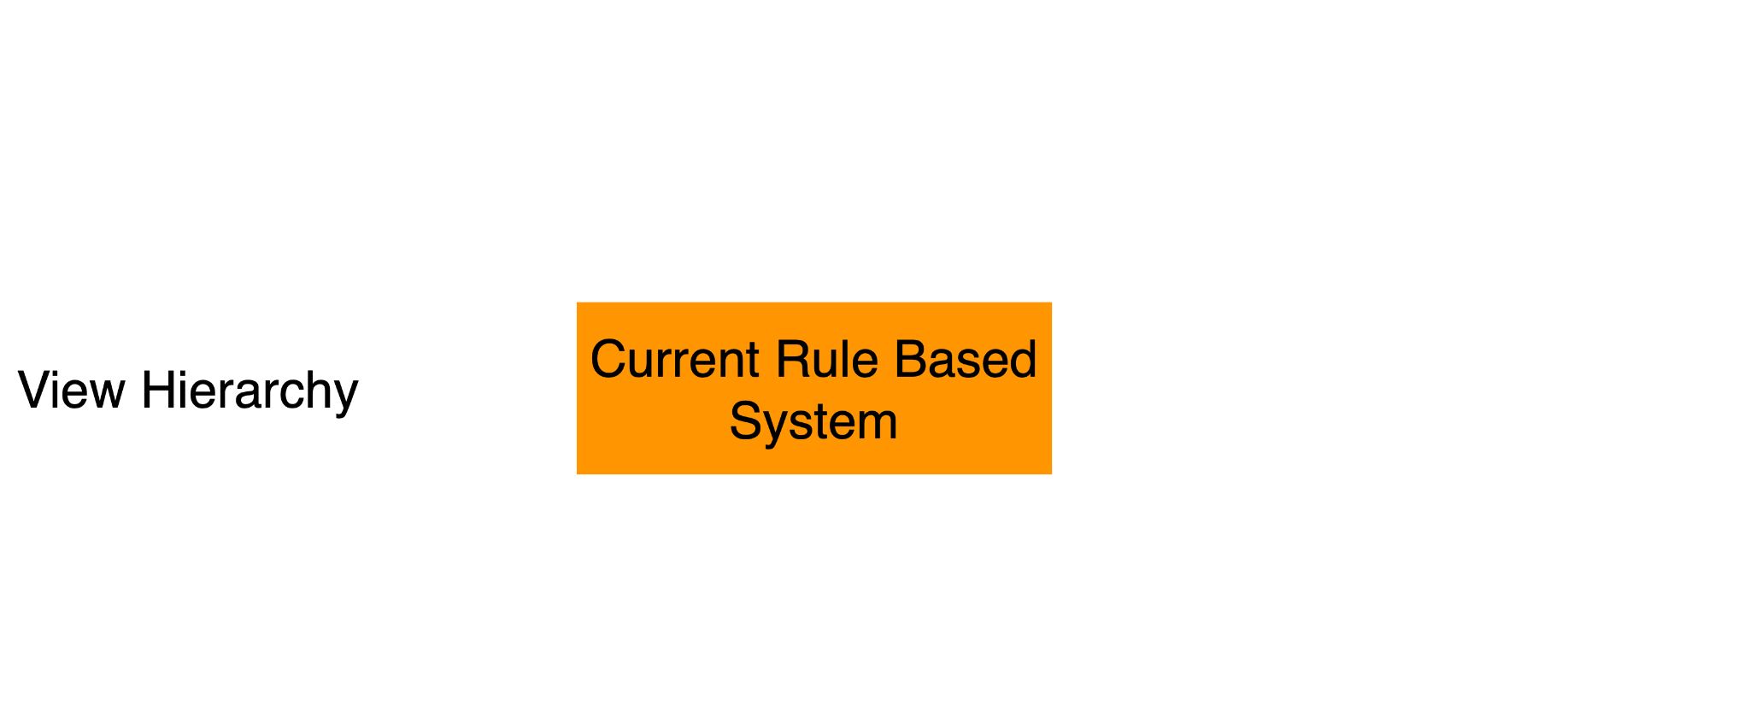
Current System

Slide 34
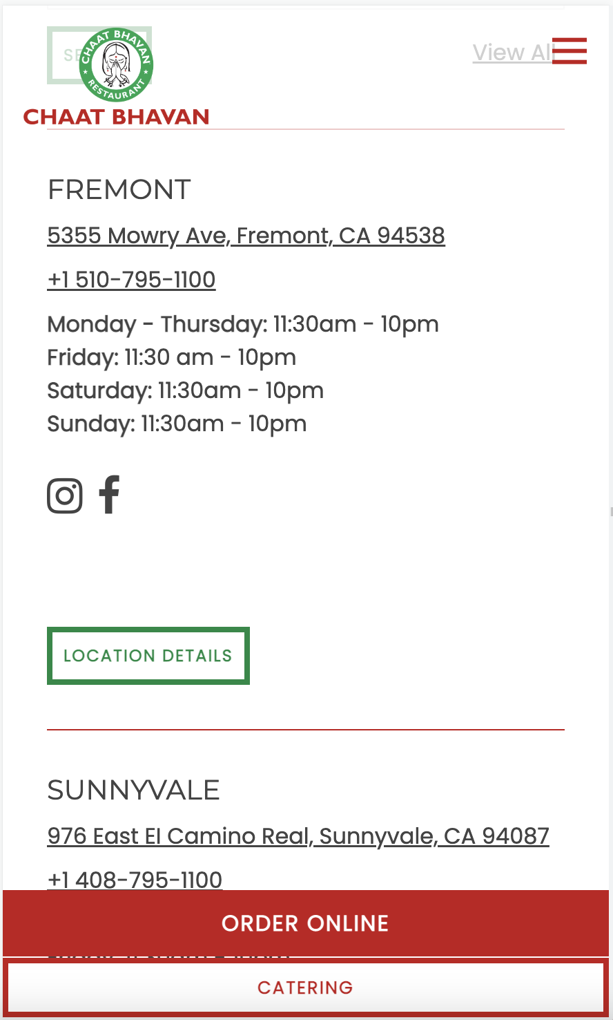
Current System
The current system can extract predefined datatypes (aka values) via rules. Nearest text element can approximate as the key for extracted value.
E.g. in the image shown Green highlight is key, blue is value

Slide 35
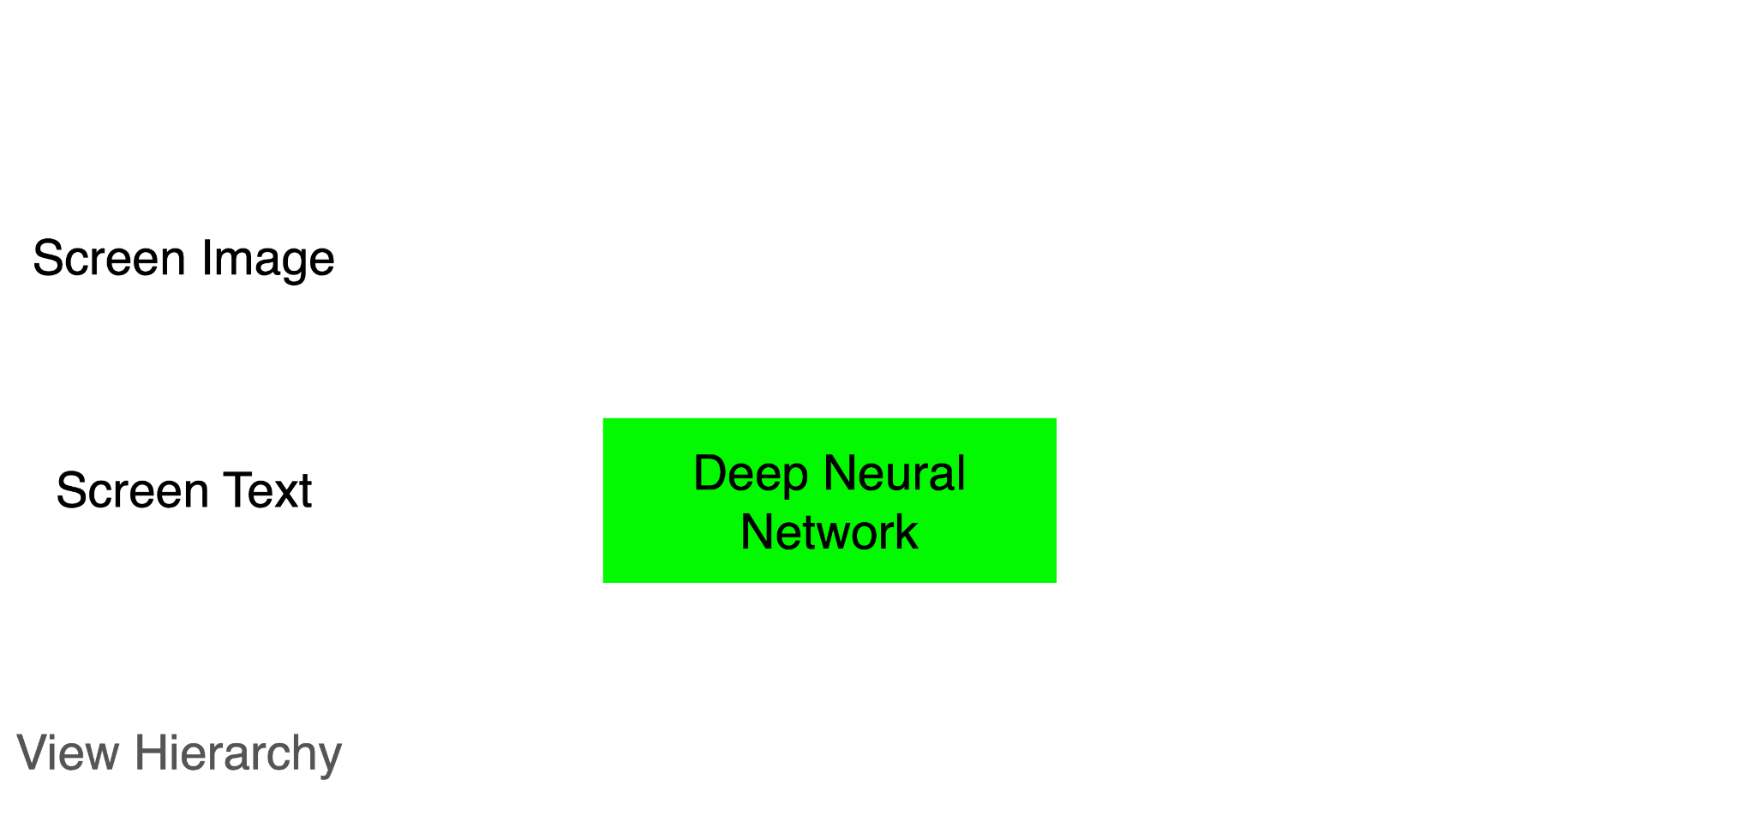
Proposed Model

Slide 36
Model related research
MarkupLM
Dataset- HTML/XML with DOM Tree
Image
Hierarchy Information
Text
LayoutLM Family
Dataset- Digital or scanned PDFs

Slide 37
How it works?

Slide 38
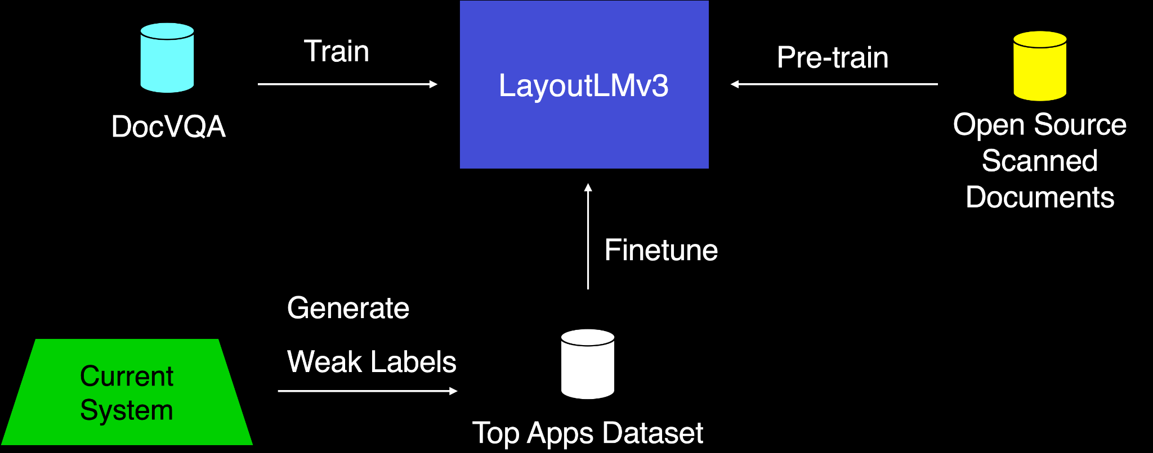
Pipeline

Slide 39
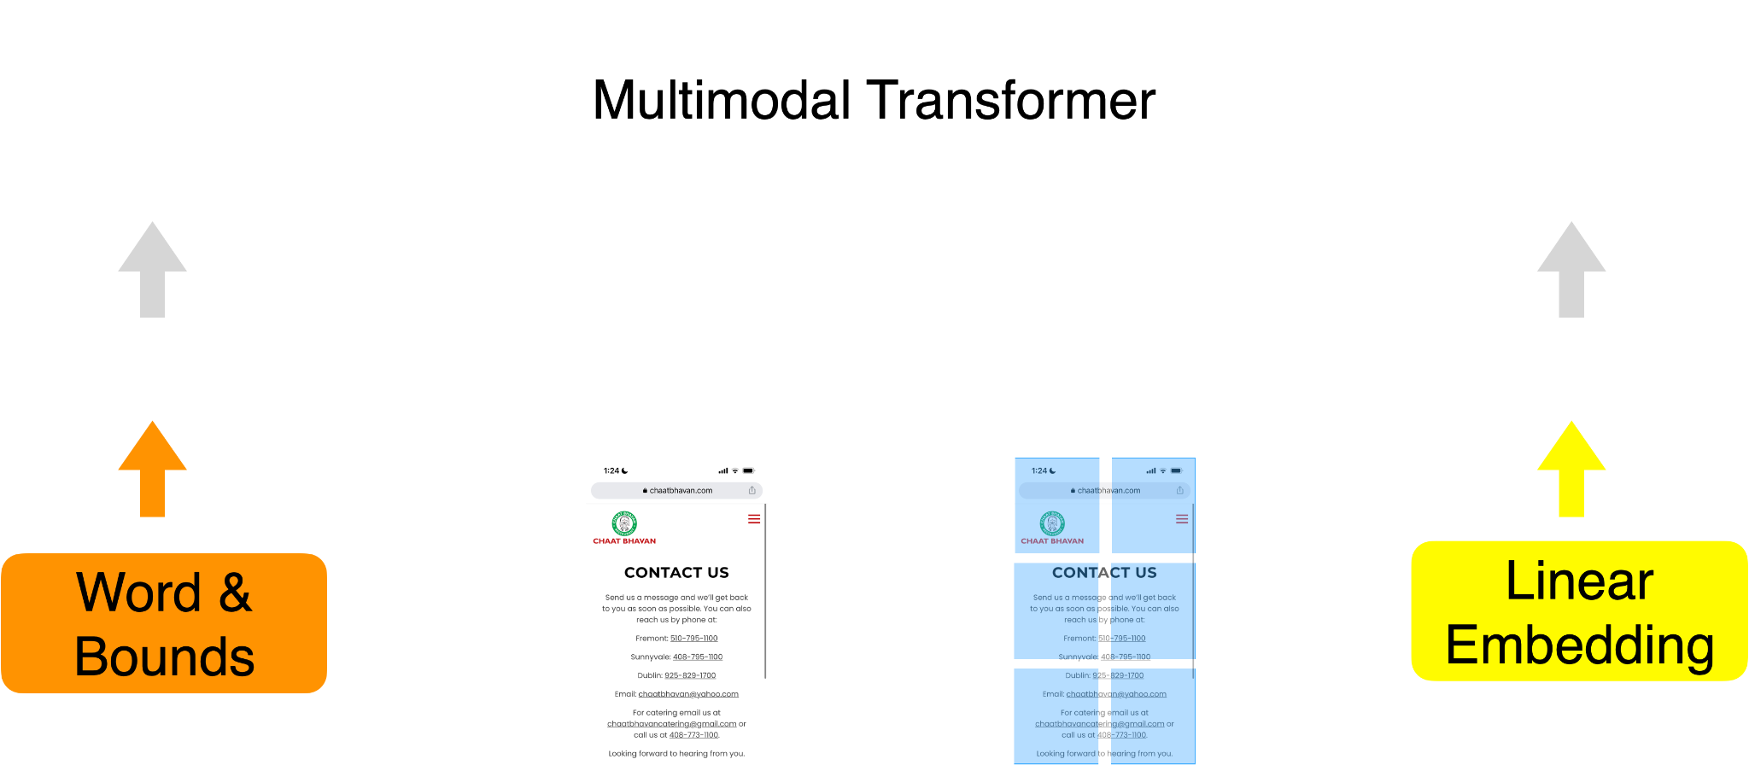
Inside LayoutLMv3

Slide 40

Demo

Slide 41
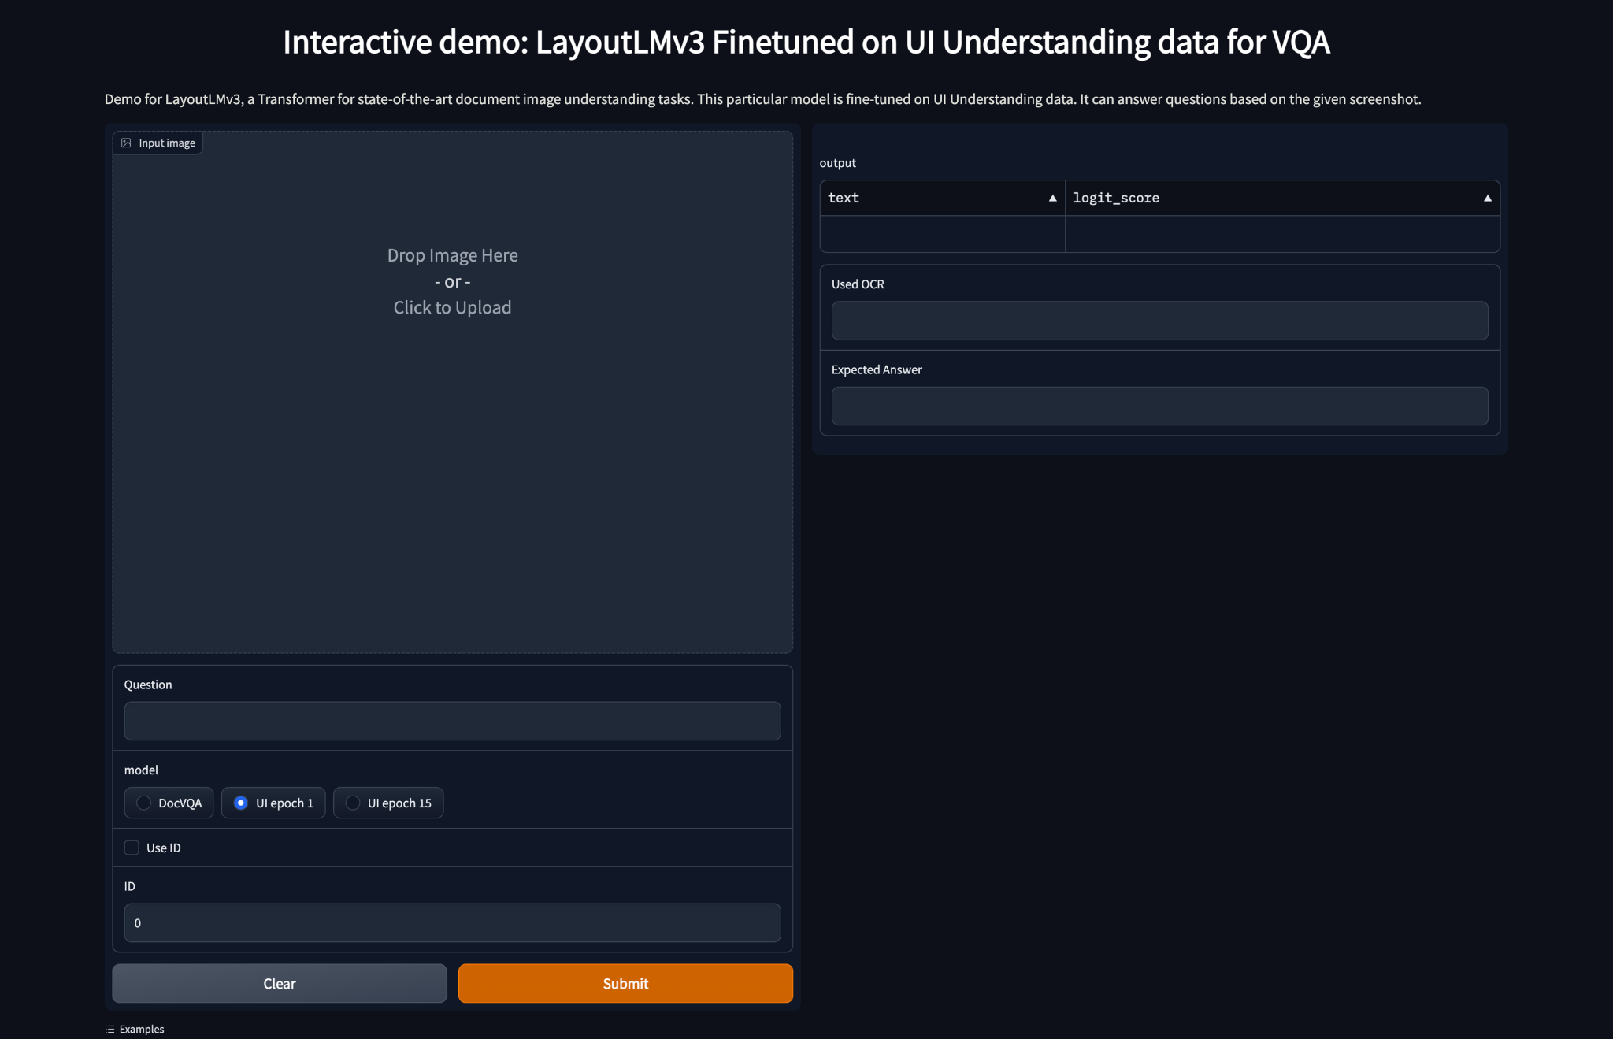

Slide 42
Robust Entity Association

Slide 43
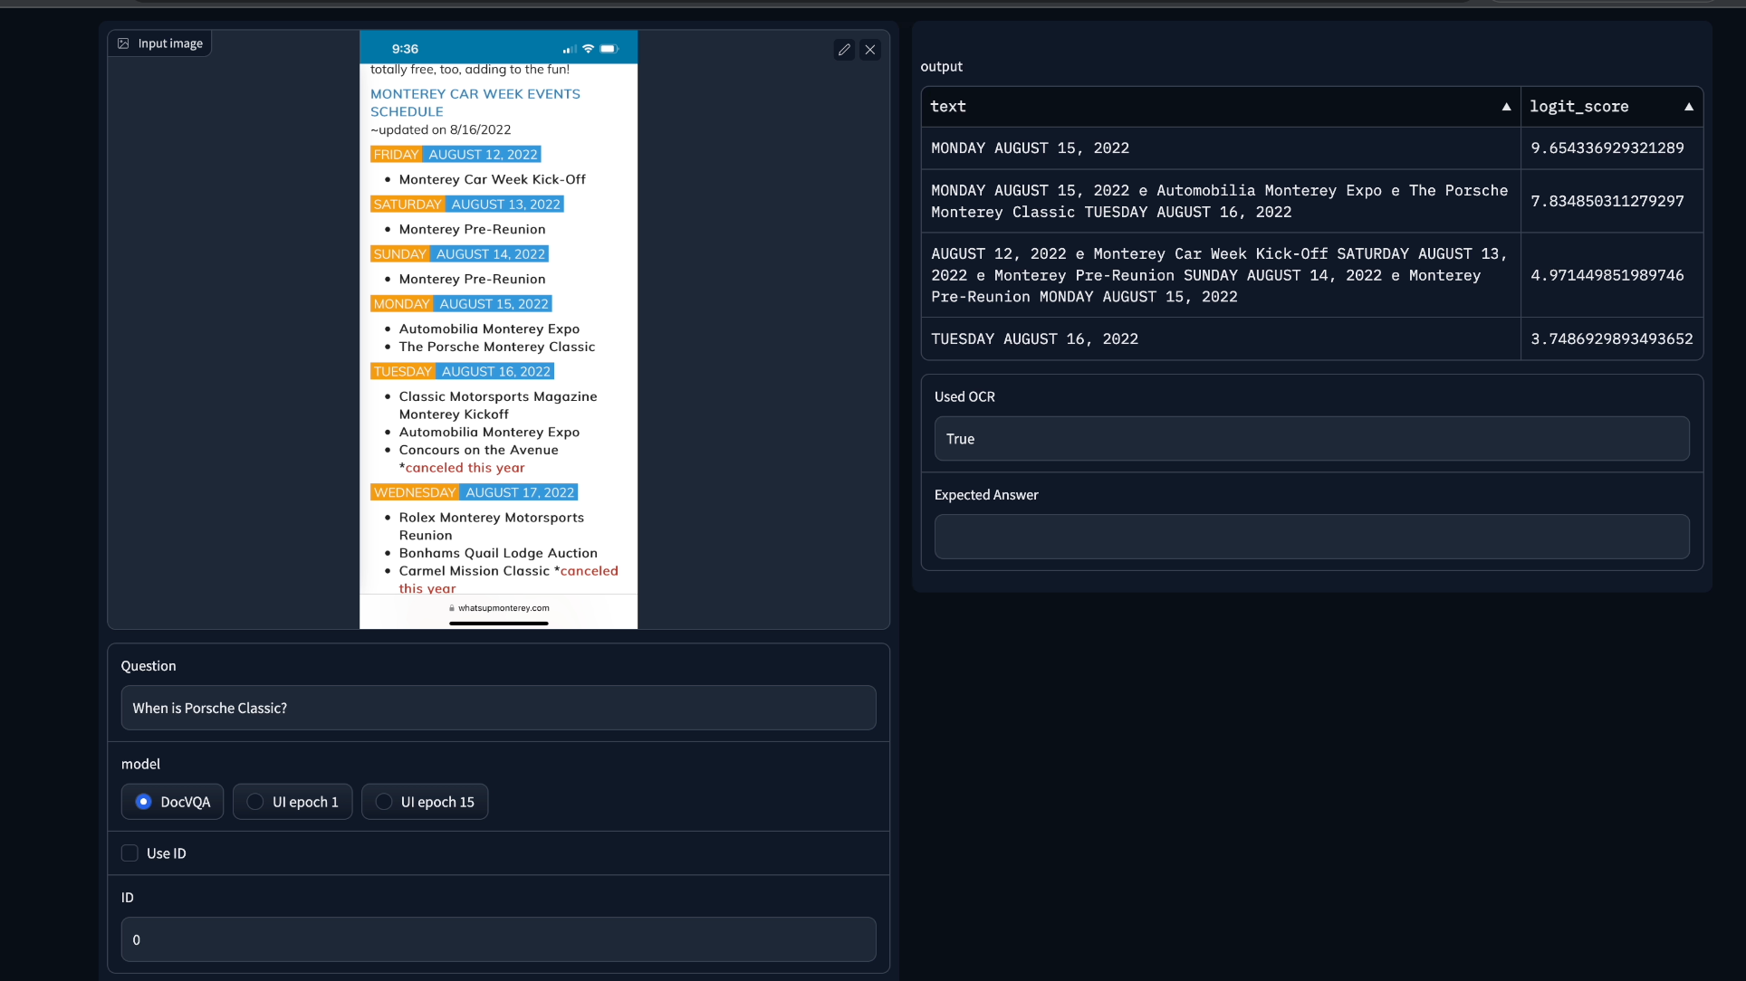

Slide 44
Generic Data Types

Slide 45
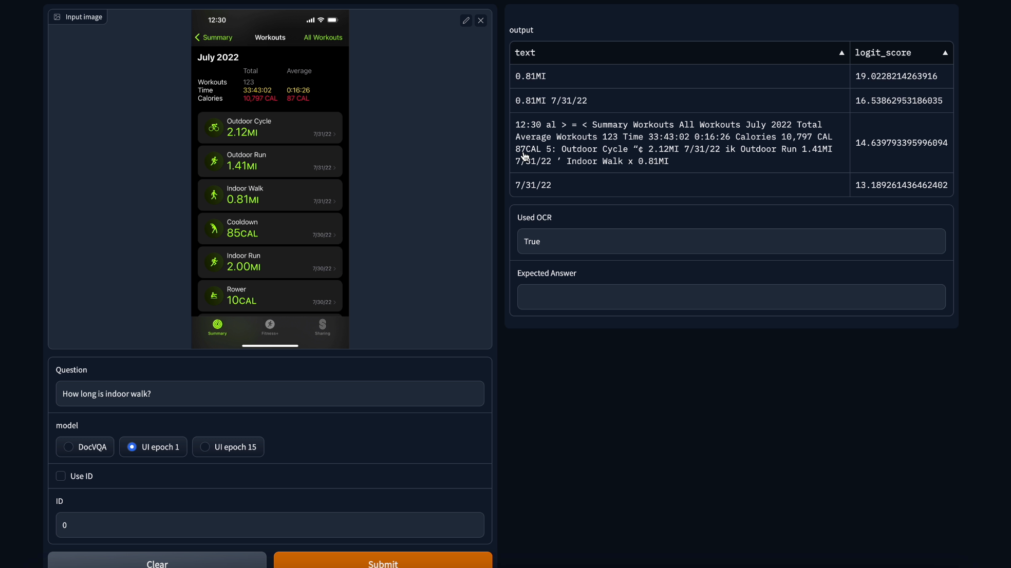

Slide 46
Images

Slide 47
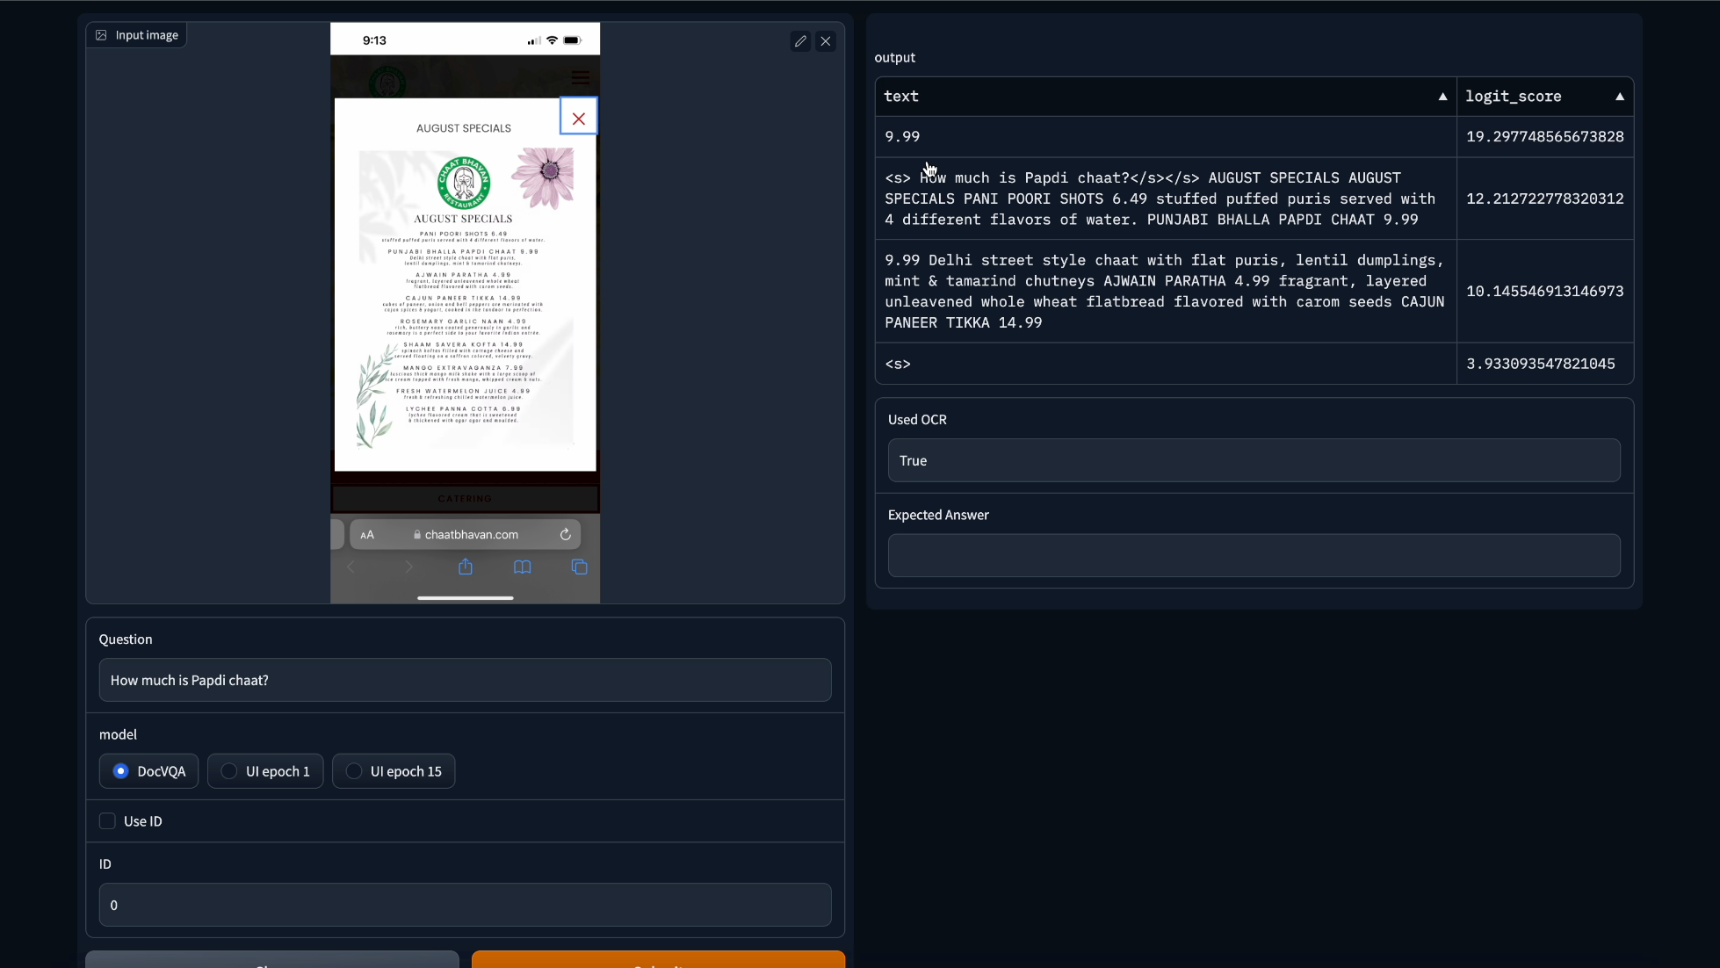

Slide 48
Natural Language

Slide 49
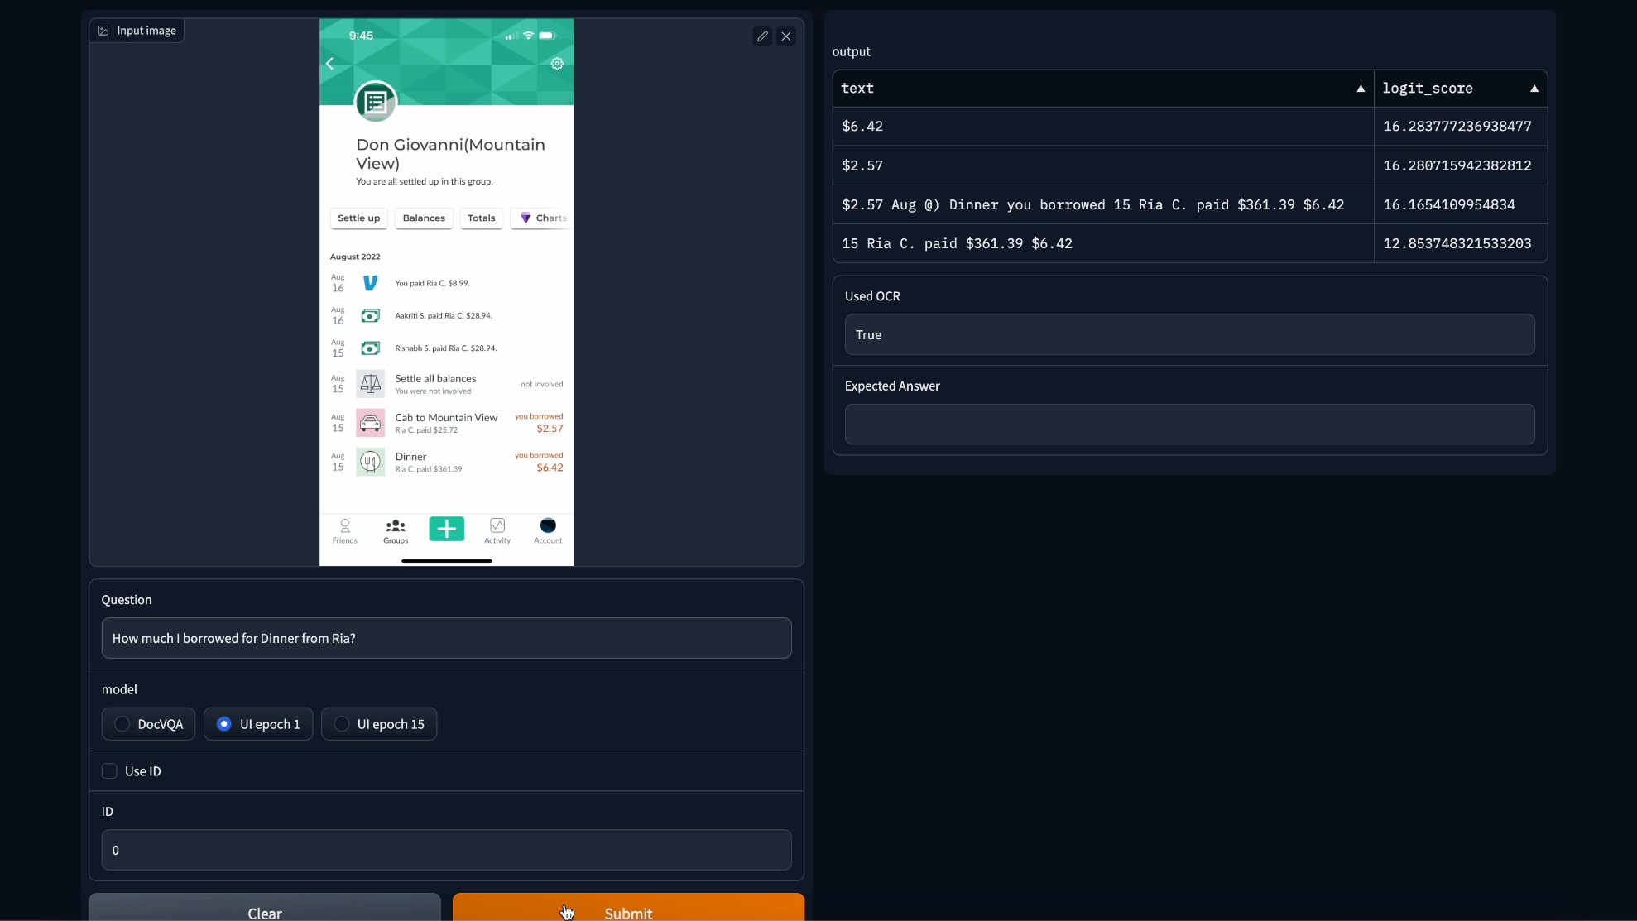

Slide 50
Tables

Slide 51
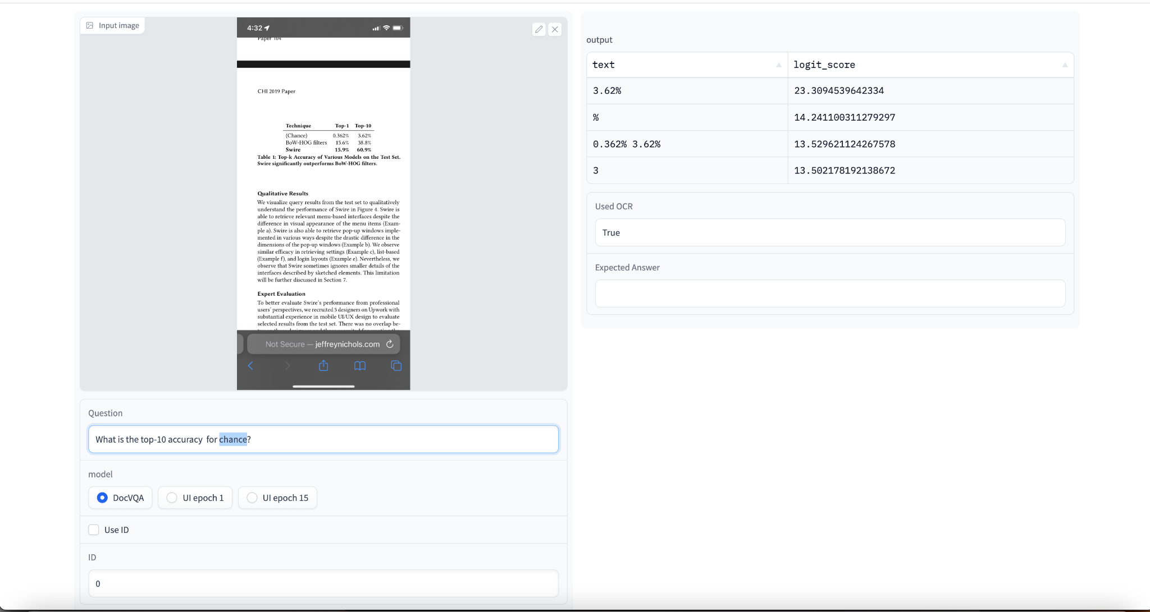

Slide 52
Future extensions
1. Using View Hierarchy information
2. Support for Infographic/ Charts understanding

Slide 53
Improving Image Retrieval in Deep Metric learning
Work done at Adobe

Slide 54
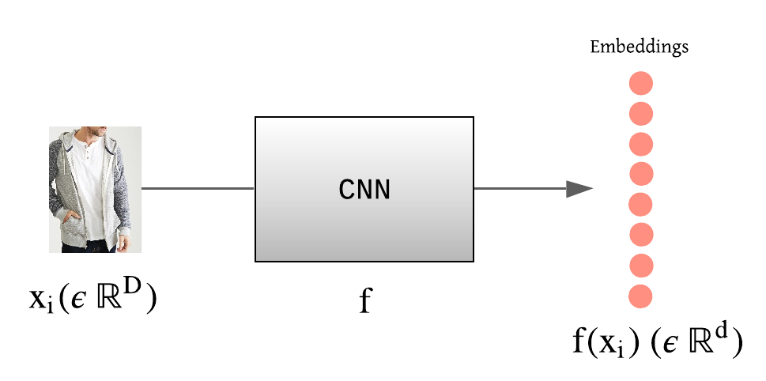
Deep Metric Learning
Aim is to learn a function to embed a query image

Slide 55
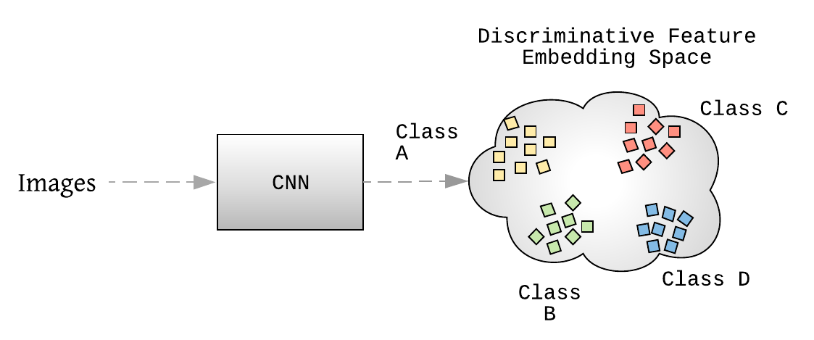
Deep Metric Learning
Aim is to learn a function to embed a query image
s.t. samples from same class closer to each other than from different class.

Slide 56
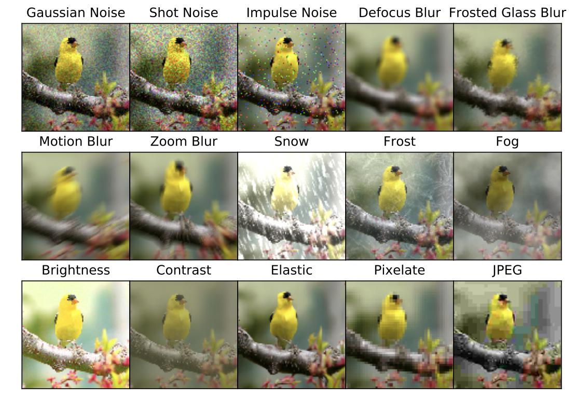
My work
My aim was given a current system with good accuracy
reduce the training time, since we had large dataset ~ 1 Billion samples
improve robustness to adversarial samples, corruption and perturbation

Slide 57
My idea
Developed attentive cutout - a gradient based masking approach based on hypothesis.
Hypothesis: In the initial training epochs the model is looking more at background to make the prediction. So mask these regions using attention map (GradCAM). Strategy: Update the mask every k epochs. Reduce percentage of masking from 50% to 0% as epochs increase.

Slide 58
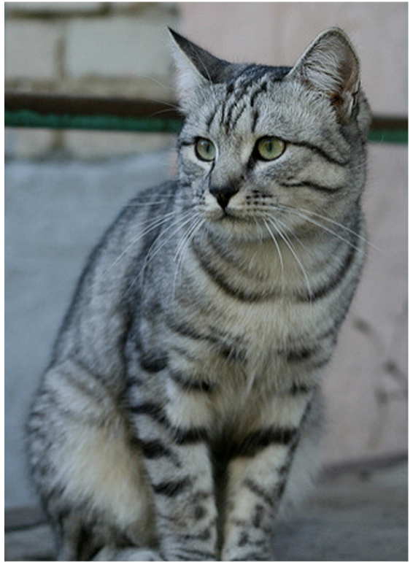
Normal inference
CNN
Loss

Slide 59
Get attention mask
CNN
Loss
Gradient

Slide 60
Cut out 50% of generated mask randomly
CNN
Loss
Gradient

Slide 61
Train for k epochs
CNN
Loss

Slide 62
Repeat to get new mask (with cut out percentage 40%)
CNN
Loss

Slide 63
Results
Model | Accuracy %
Original | 60.65
Original (FGSM) | 14.27
Original (PGD) | 2.13
Random Cutout | 65.11
Random Cutout (FGSM) | 12.31
Random Cutout (PGD) | 1.91
Attentive Cutout | 63.17
Attentive Cutout (FGSM) | 13.76
Attentive Cutout (PGD) | 2.38
Classification of CIFAR100
ResNet44
See a ½ reduction in training epochs to reach same performance

Slide 64
Results
In-Shop Clothes Retrieval See a ⅓ reduction in training epochs to reach same performance
Model | Recall@1 %
Original | 87.5
Random Cutout | 88.2
Attentive Cutout | 88.1

Slide 65
Graph Neural Networks for Image Classification using Graph representations
Work done at Columbia University

Slide 66
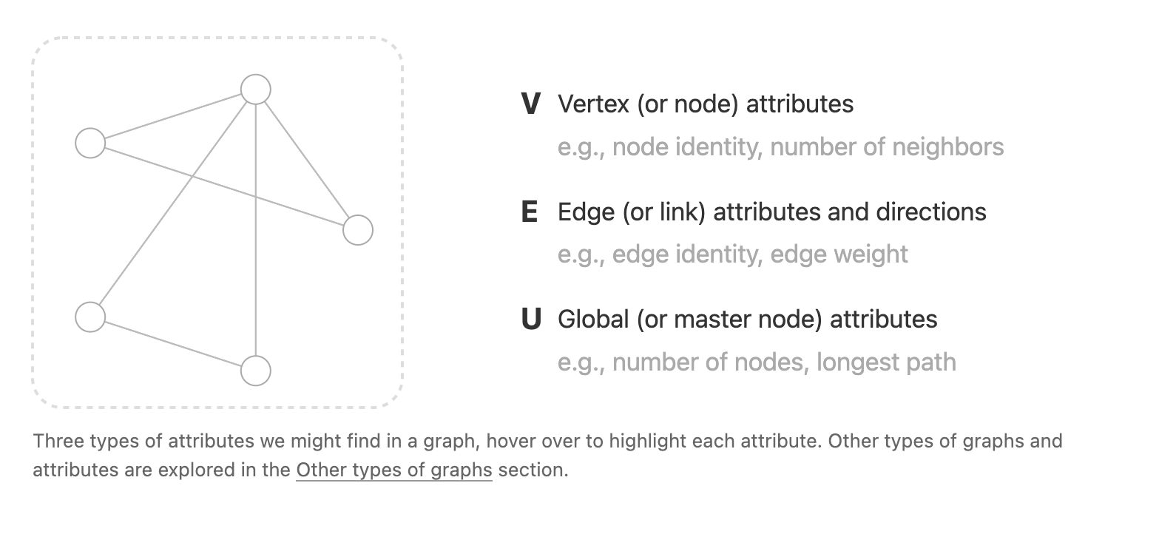
Graph Neural Networks Overview
1. Graph Attributes

Slide 67
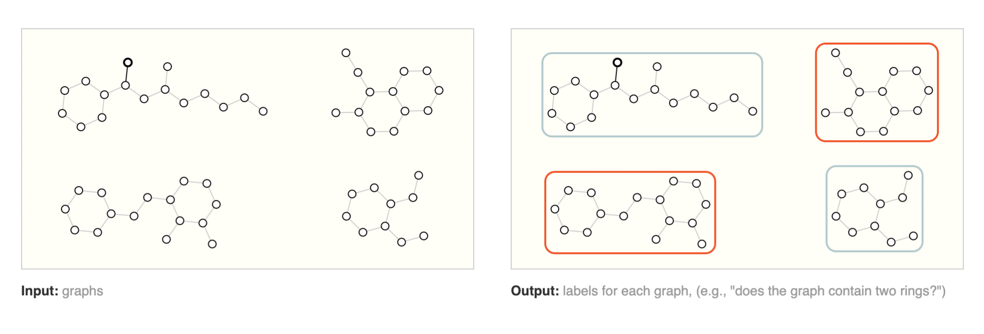
Type of Tasks
Graph level task - classify whole graph

Slide 68
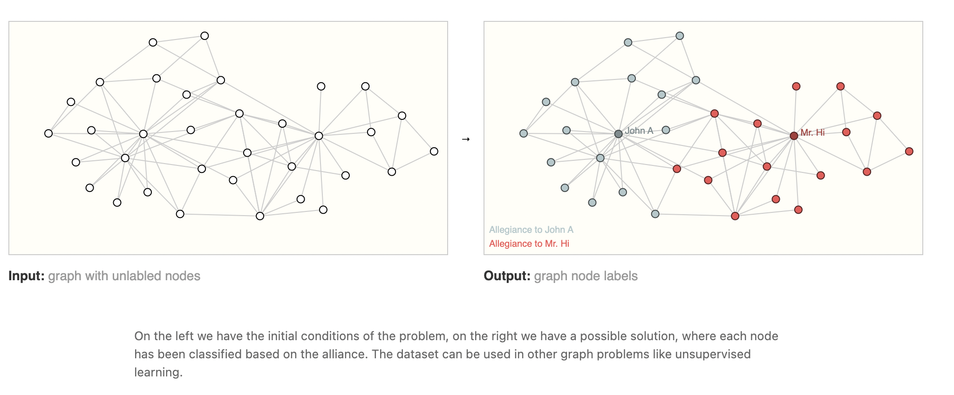
Type of Tasks
Node level task - classify each node

Slide 69
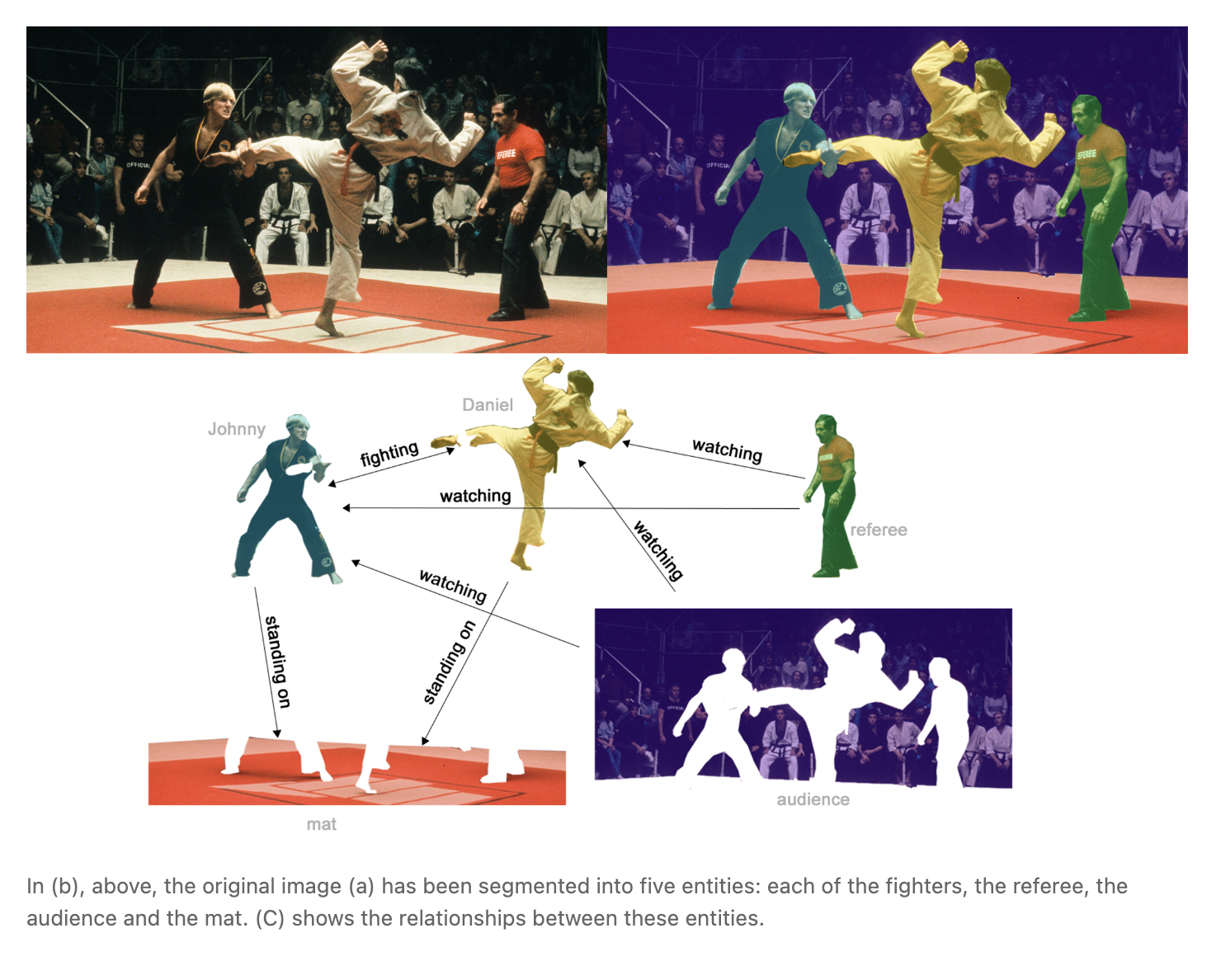
Type of Tasks
Edge level task
Image scene understanding

Slide 70
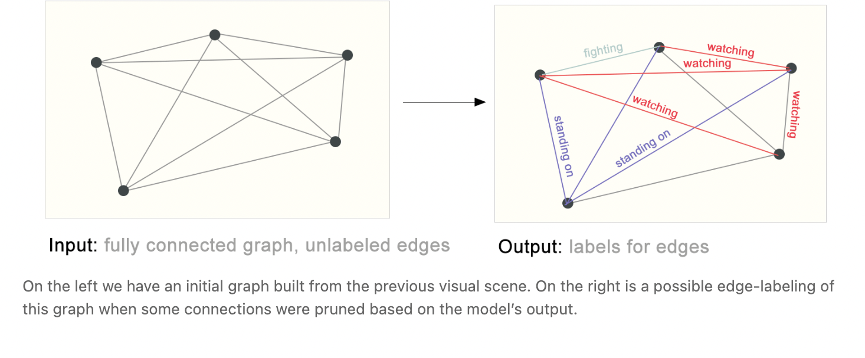
Type of Tasks
Edge level task (2)

Slide 71
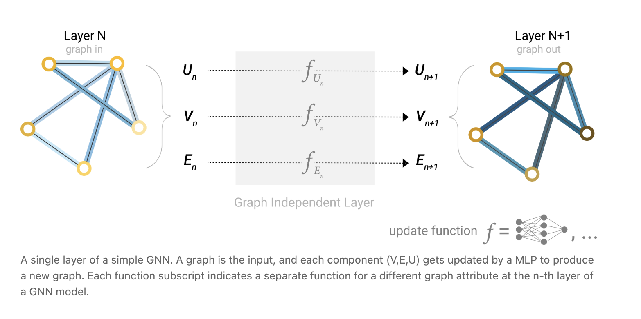
Layers in Graphs Neural Network
Simple GNN layer

Slide 72
Layers in Graphs Neural Network
Message passing works in three steps:
gather all the neighboring node embeddings
Aggregate via an aggregate function (like sum).
Transform pooled messages using update function, usually a learned neural network.

Slide 73
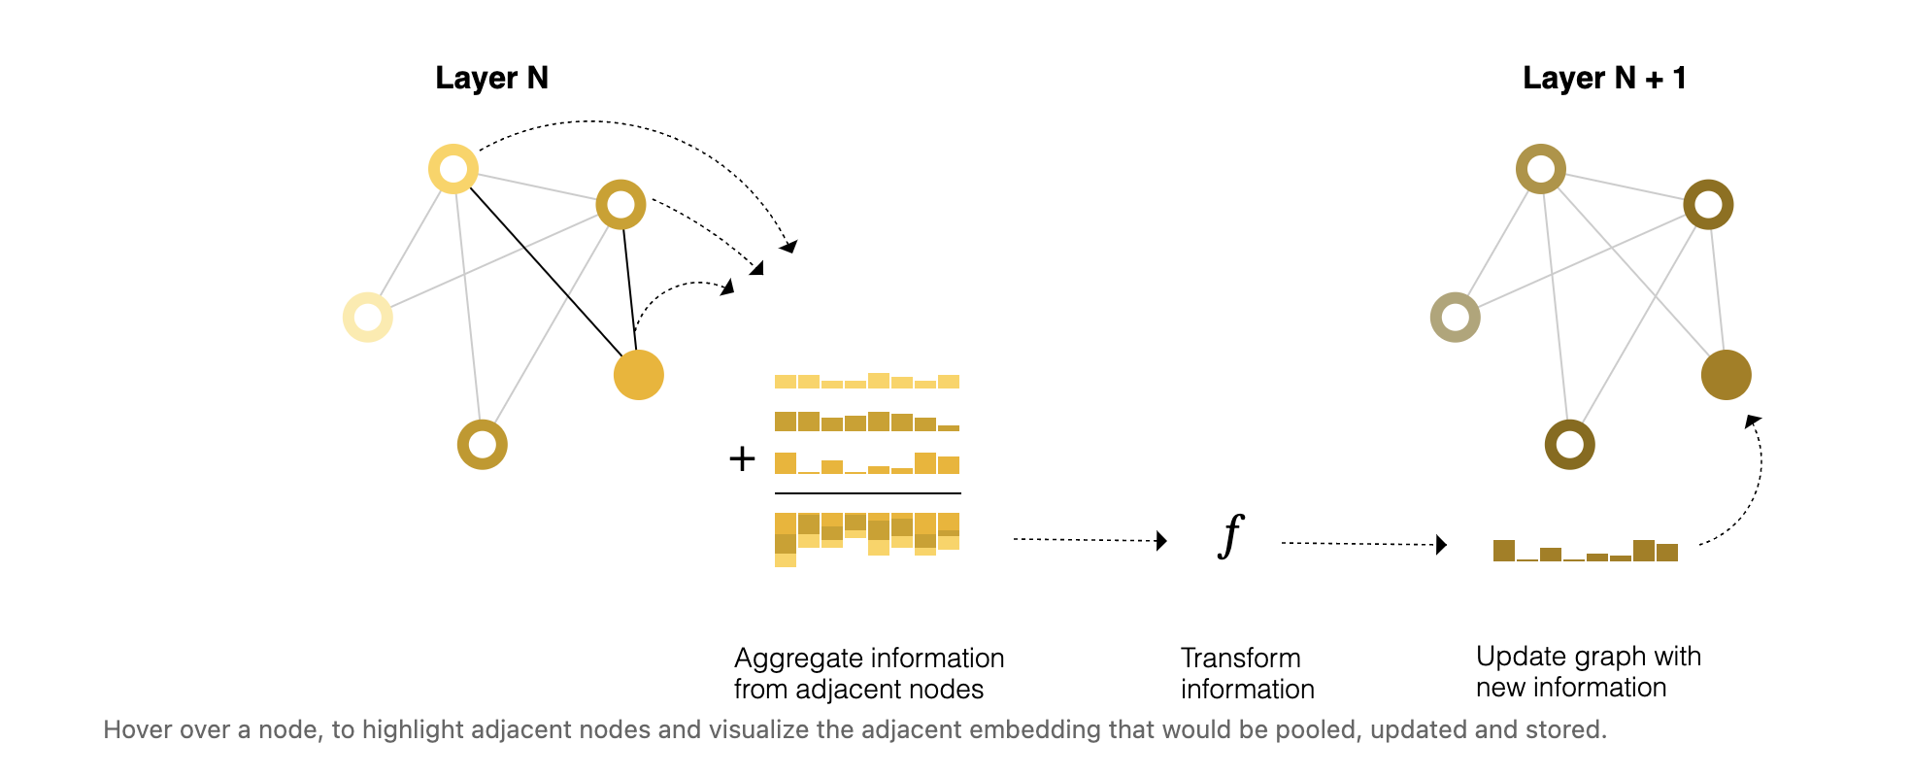
Layers in Graphs Neural Network
Message Passing

Slide 74
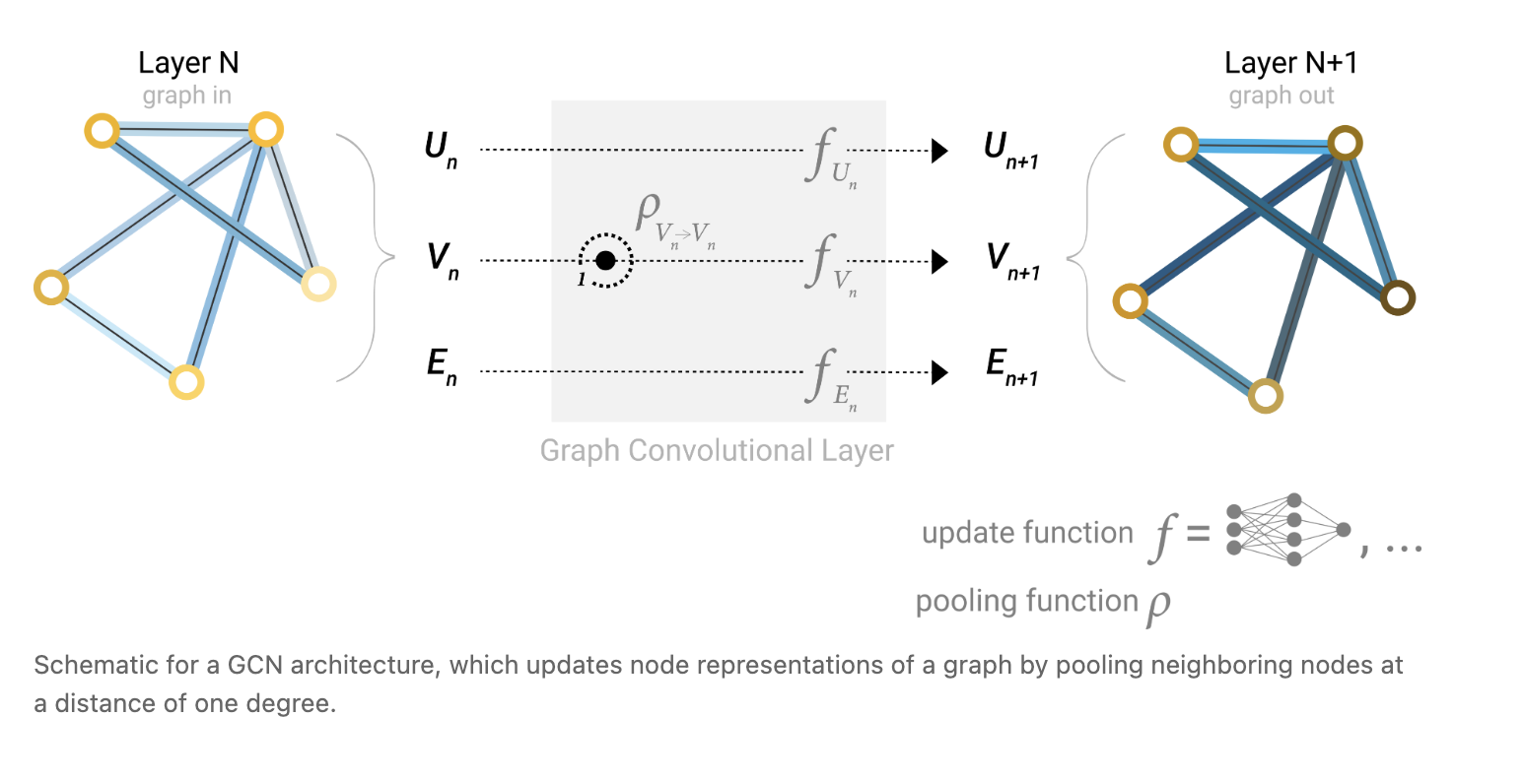
Layers in Graphs Neural Network
GCN layer

Slide 75

My Work in GNN (1)
https://arxiv.org/pdf/2203.03457.pdf

Slide 76
My Work in GNN (2)
Improve over trivial band like Dense graph representation i.e. Trivial map Node = pixel Edge = connect 8 neighbour
Our proposal a new representation for a image as graph Node = Superpixel Edge = Relative distance between 2 superpixel in image space

Slide 77
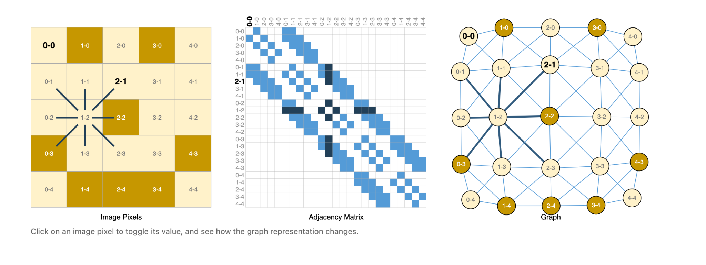
Encoding an image
Dense graph - usual representation - band link Dense representation

Slide 78
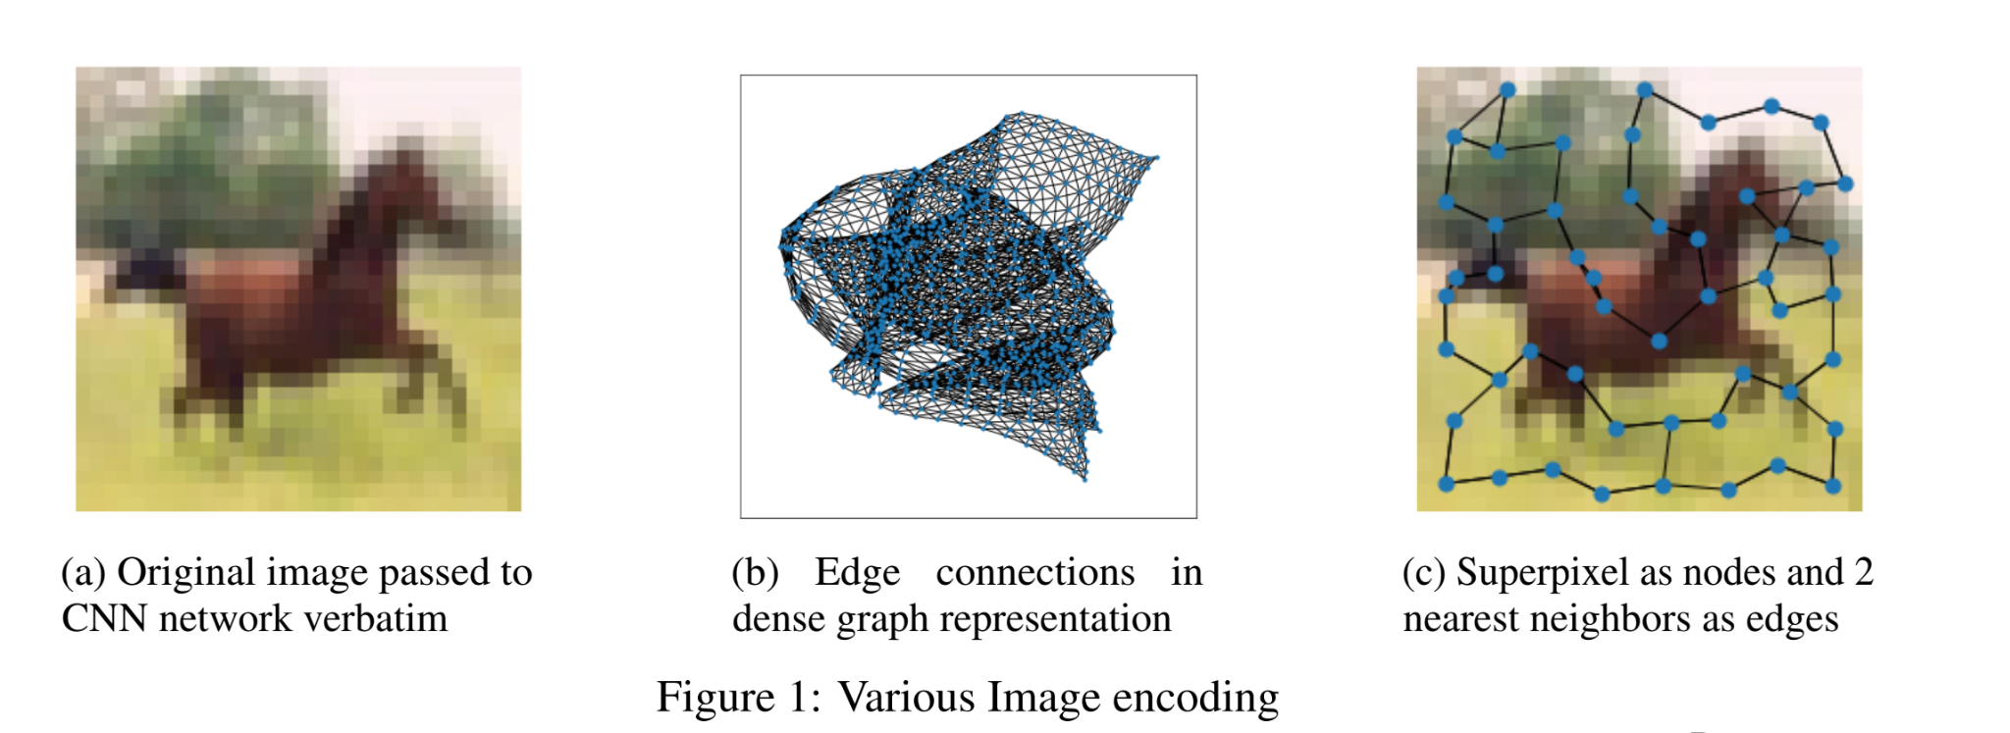
Proposed Superpixel based mapping
4

Slide 79
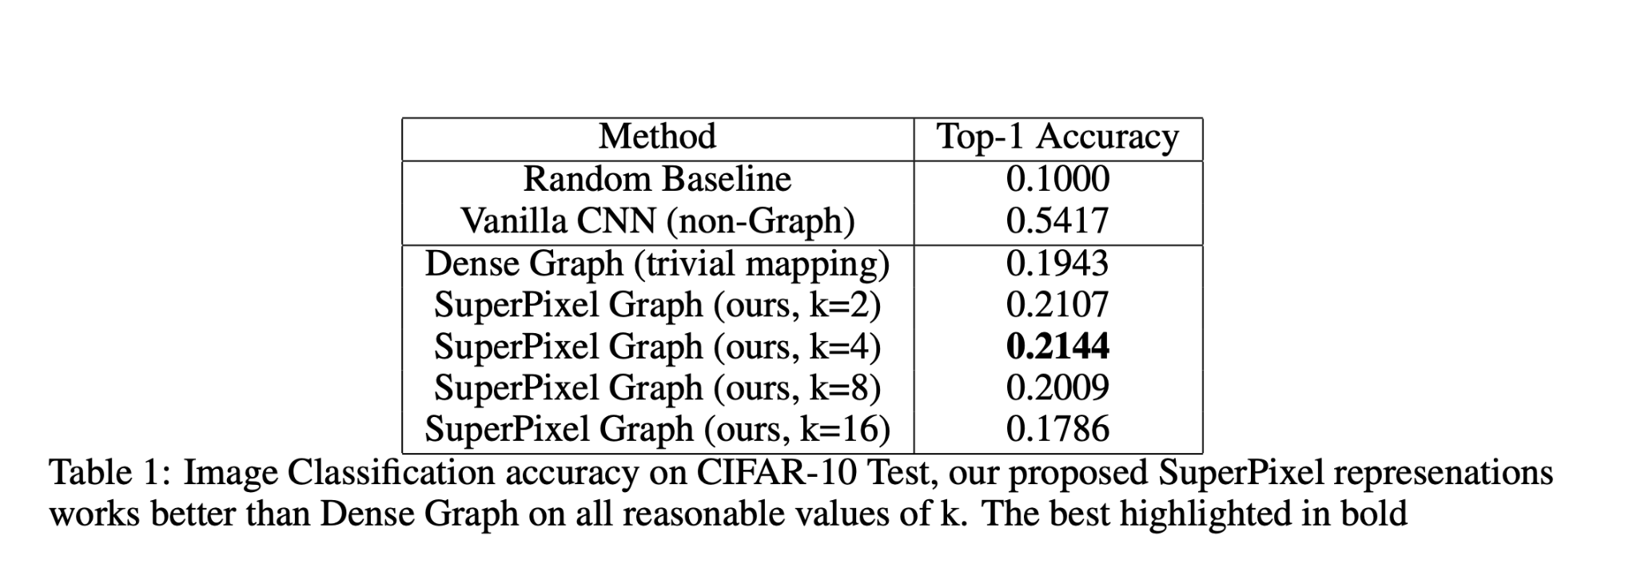
Comparison with SOTA
Show better performance than current SOTA on graph level task of image classification

Slide 80
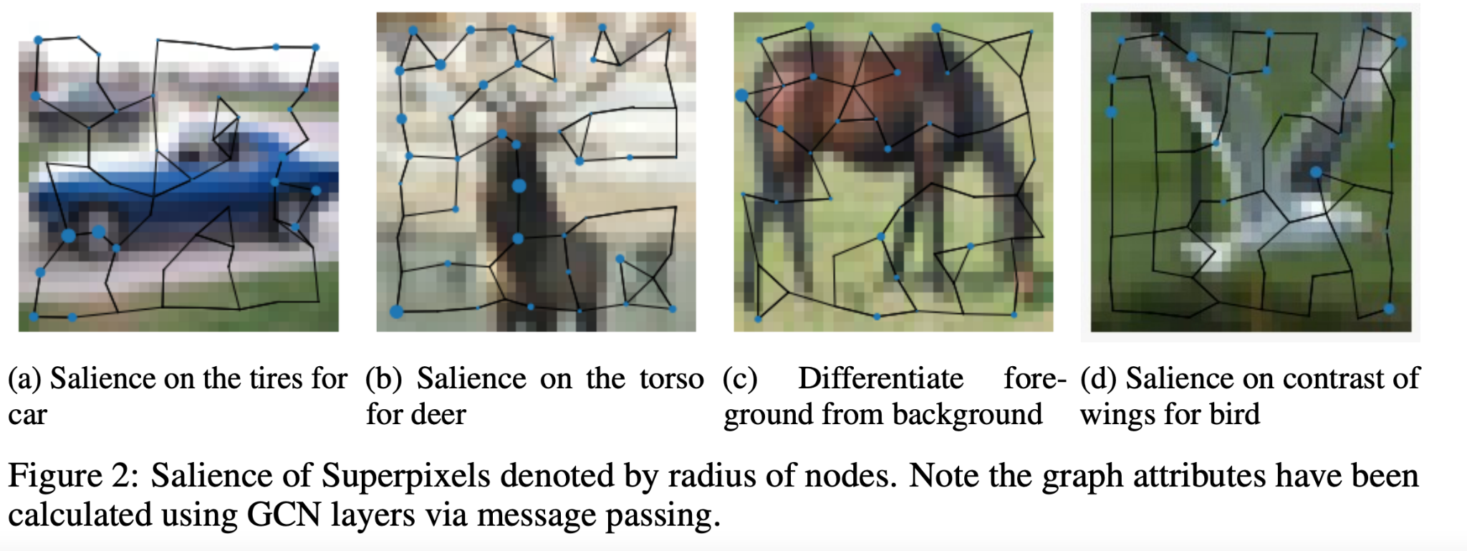
Interpretability
4. Work on interpretability aspects by using radius as attribution saliency

Slide 81
Conclusions (1)
Our representation has smaller dimensionality and leads to much more interpretable results.
Still there is a large gap between SOTA of CNN and GNN (ours).
Major issue GNN works well on node-level and edge-level tasks but not on graph-level tasks like image classification.

Slide 82
Conclusions (2)
May be due to lack of scale invariance in graph. The various layers in a CNN network, can be approximated to looking at an image at various scales, but the same is not true for GNN.
Possible future directions involve adding scale invariance
exploring a hierarchy based collapsing of nodes, where in nodes nearby are collapsed into a single node in a hierarchical manner to achieve scale invariance
exploring graph attention layers.

Slide 83
Self Supervised learning approaches for
improving Multimodal representation learning

Slide 84
Content
Overview and Challenges in multimodal learning
Approaches for self supervised learning
Cross-modal pretraining for transformers
Cross-modal generation
Cyclic translation
Unimodal label generation and multi-task learning

Slide 85
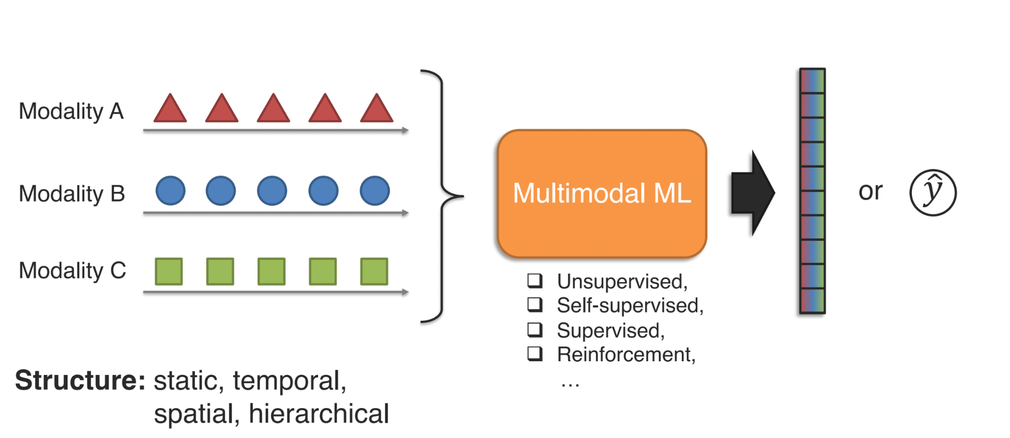
Multimodal learning overview
https://cmu-multicomp-lab.github.io/mmml-tutorial/schedule/

Slide 86
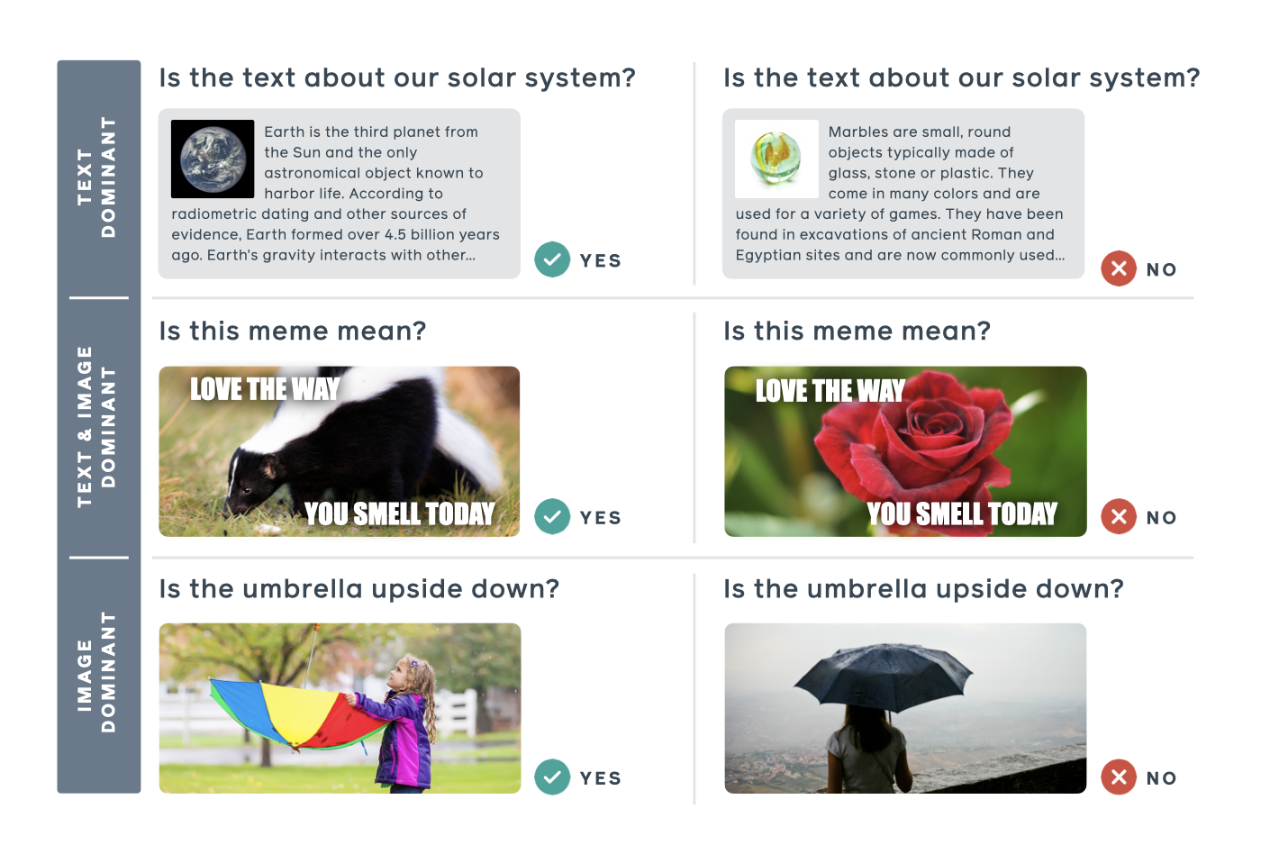
Example task - Hateful Meme challenge
Three types of tasks for understanding content. The middle category requires multimodal learning in order to understand the overall meaning.
https://ai.facebook.com/blog/hateful-memes-challenge-and-data-set/

Slide 87
Challenges in multimodal learning
Limited datasets for multimodal settings
Need matched pairing between modalities
Can have datasets with different sets of modalities

Slide 88
Cross-modal pretraining for transformers
Predict words by looking at audio and visual context in addition to the context words around the masked input. For example, “This movie is [MASK]”
[MASK] predicted as “amazing” if the audio and visual features show that speaker is happy.
[MASK] predicted as “terrible” if the speaker seems discontent while talking.
This information cannot be derived from text only input.

Slide 89
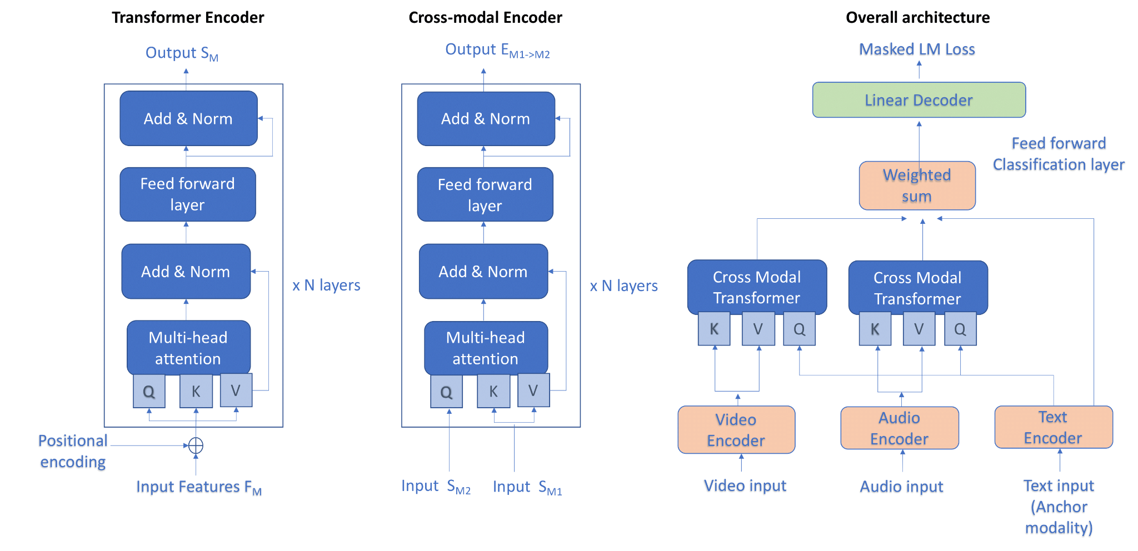
Cross-modal pretraining for transformers
Cross-modal transformer based self-supervised learning architecture

Slide 90
2. Cross-modal generation
In is addition to conventional cross-modal feature embedding introduce generative models: image-to-text and text-to-image
3 step approach given a query in image or text
first look at the query to extract an abstract representation.
Then, imagine what the target item (text or image) in the other modality should look like. Basically, using the representation of one modality to generate the item in the other modality.
After that match the generated modality with actual modality using image-text pairs

Slide 91
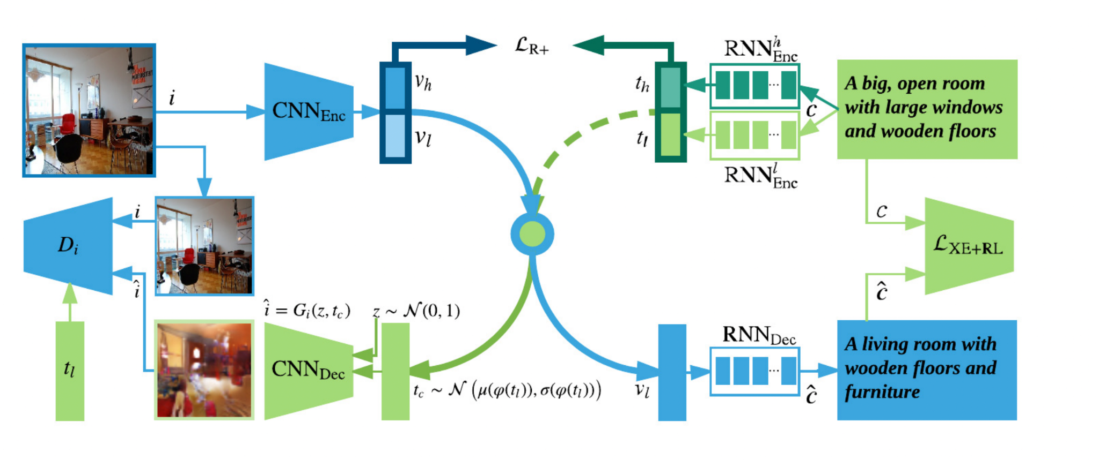
2. Cross-modal generation
The entire system consists of three training paths:
multi-modal feature embedding (the entire upper part)
image-to-text generative feature learning (the blue path)
text-to-image generative adversarial feature learning (the green path)

Slide 92
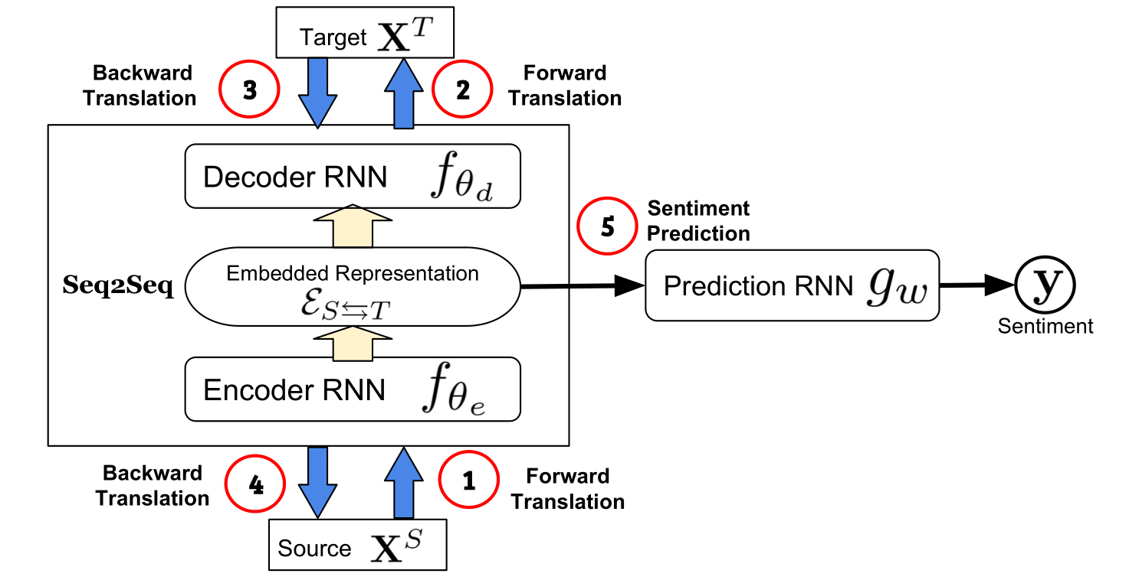
3. Cyclic translation
Learn robust joint representations by translating between modalities
Augment modality translations with a cycle consistency loss.
Once the translation model is trained with paired multimodal data, one only needs data from the source modality at test time.

Slide 93
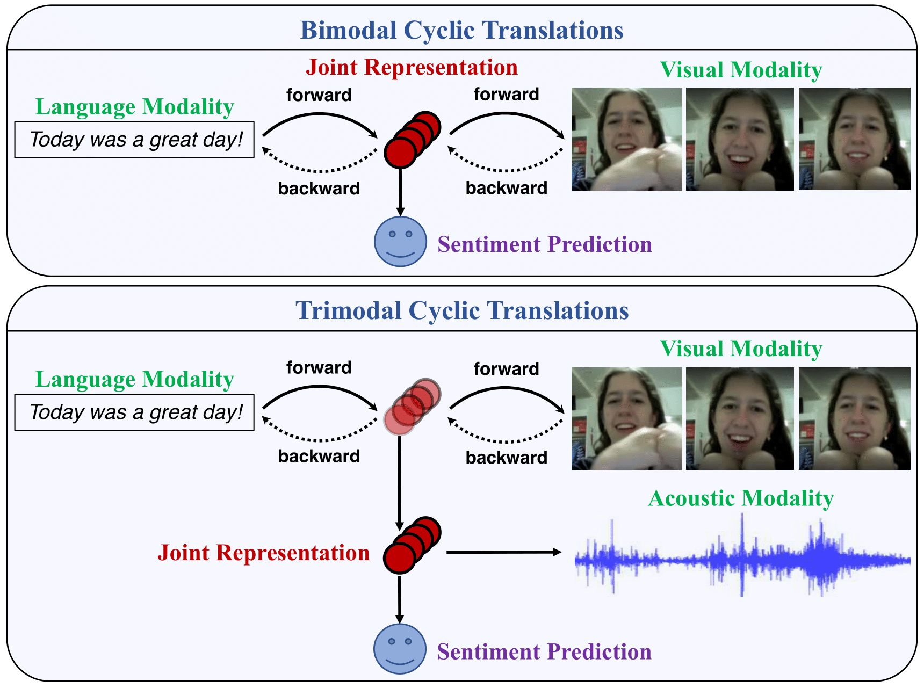
3. Cyclic translation
Learning robust joint representations via multimodal cyclic translations.

Slide 94
4. Unimodal label generation and multi-task learning
Representation learning only using multimodal labels is only targets at learning differential information.
But usually unimodal labels for a multimodal dataset are not available.
Hence propose a strategy to generate unimodal labels in self supervised fashion. These unimodal labels are joined used with multimodal labels to train the model.

Slide 95
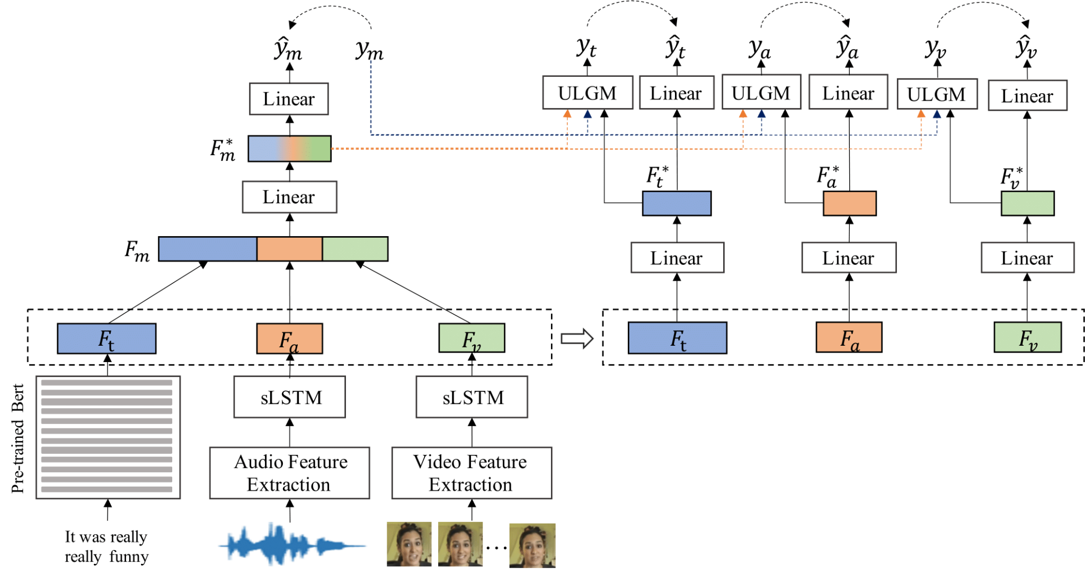
4. Unimodal label generation and multi-task learning
The overall architecture of Self-Supervised Multi-task Multimodal model.
The ŷ_{m}, ŷ_{t}, ŷ_{a},and ŷ_{v} are the predictive outputs of the multimodal task and the three unimodal tasks, respectively.

Slide 96
Questions/ Feedback
Naman,
MS Computer Science (Thesis), Columbia University
Bachelors IIT India, Institute Rank 1
Previously - Apple, NAVER, Adobe, Microsoft
ng2848@columbia.edu

